Slide 1
Auto-regulation of PfSR1in plasmodium falciparum
Shany Assaraf
P.I: Ron Dzikowski
Department of Microbiology & Molecular Genetics, IMRIC, Hebrew University-Hadassah Medical School, Jerusalem, Israel.

Slide 2
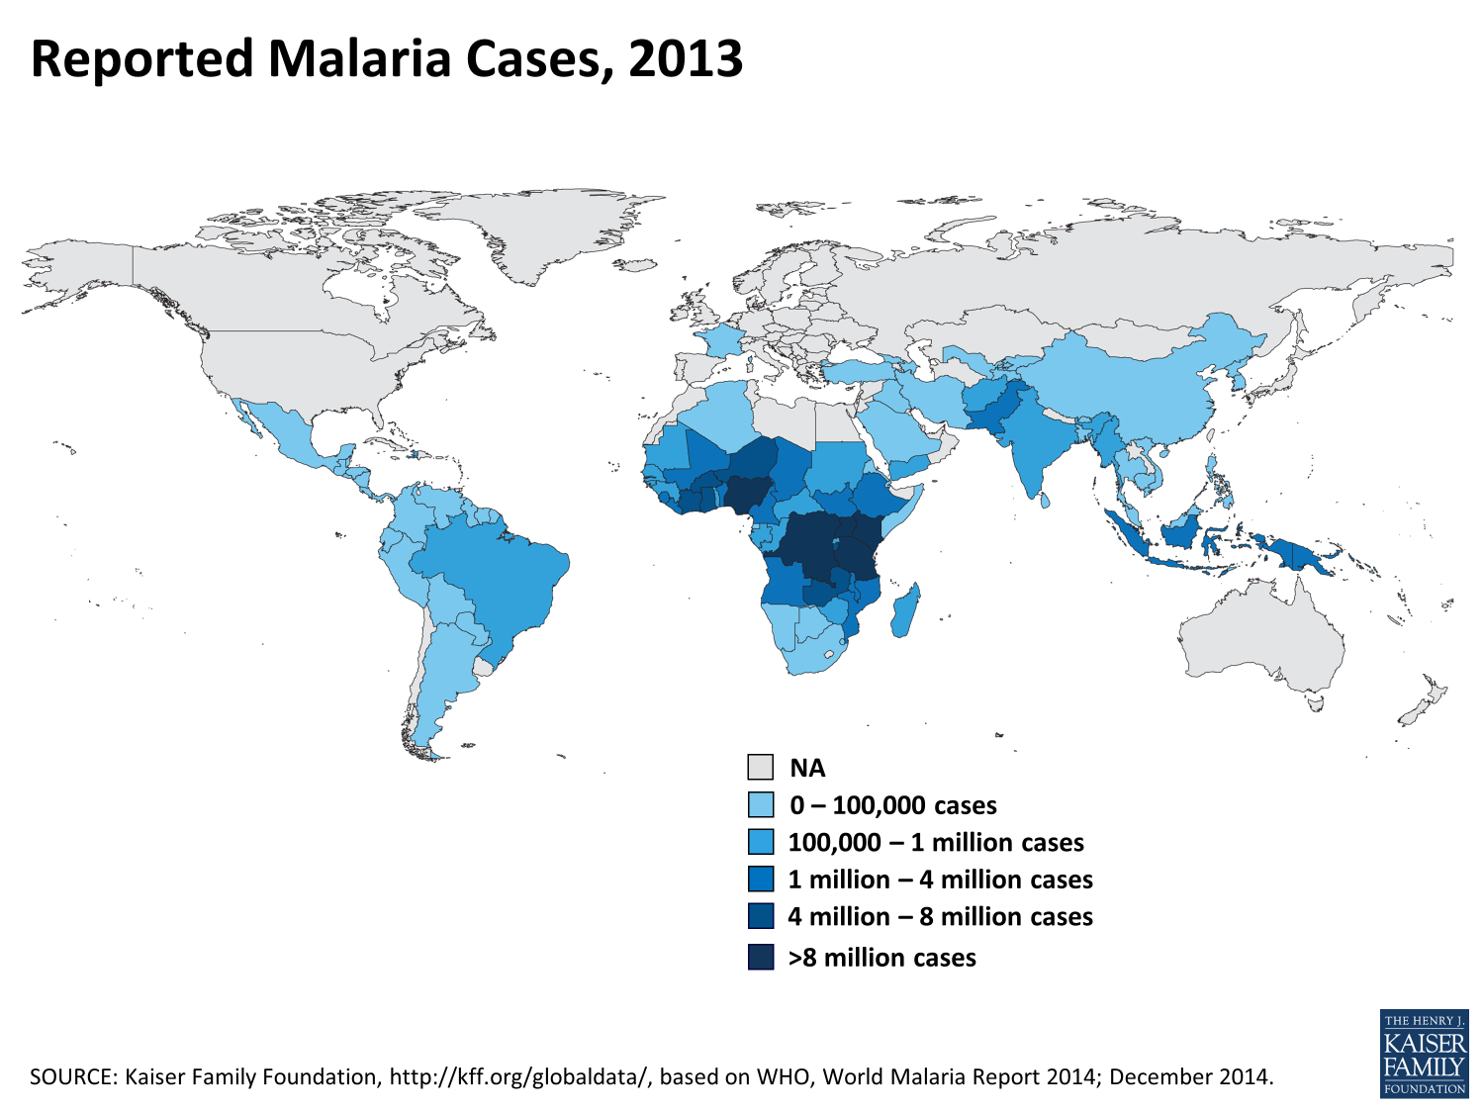
Plasmodium falciparum
protozoan parasite responsible for deadliest form
of human malaria
Transmitted exclusively through the bites of Anopheles
mosquitoes

Slide 3
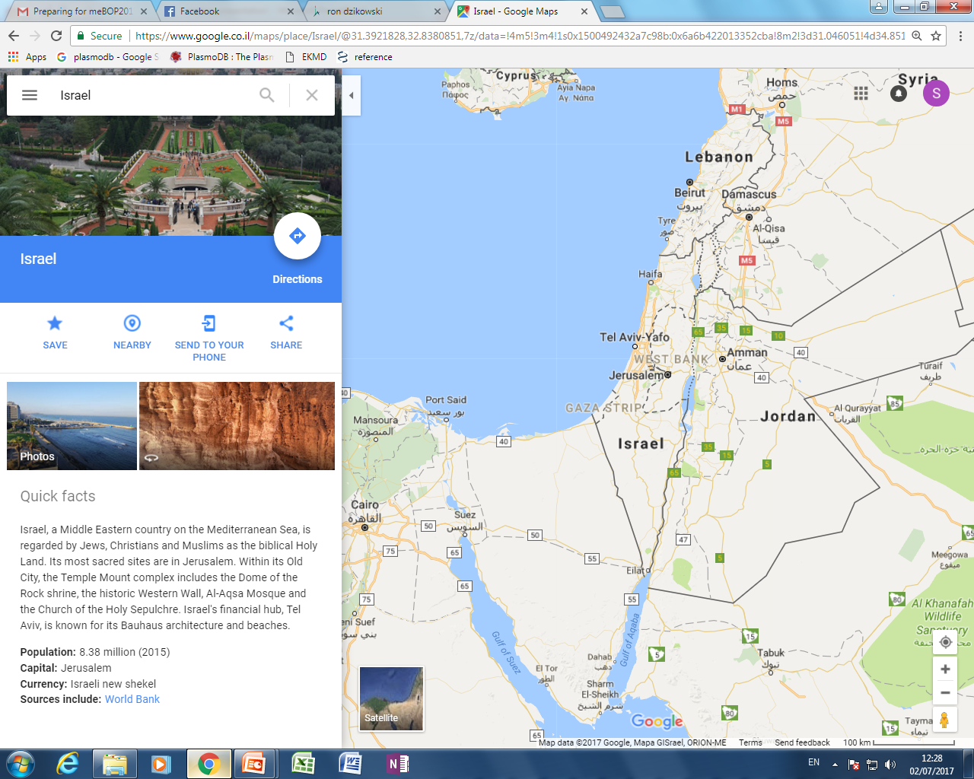
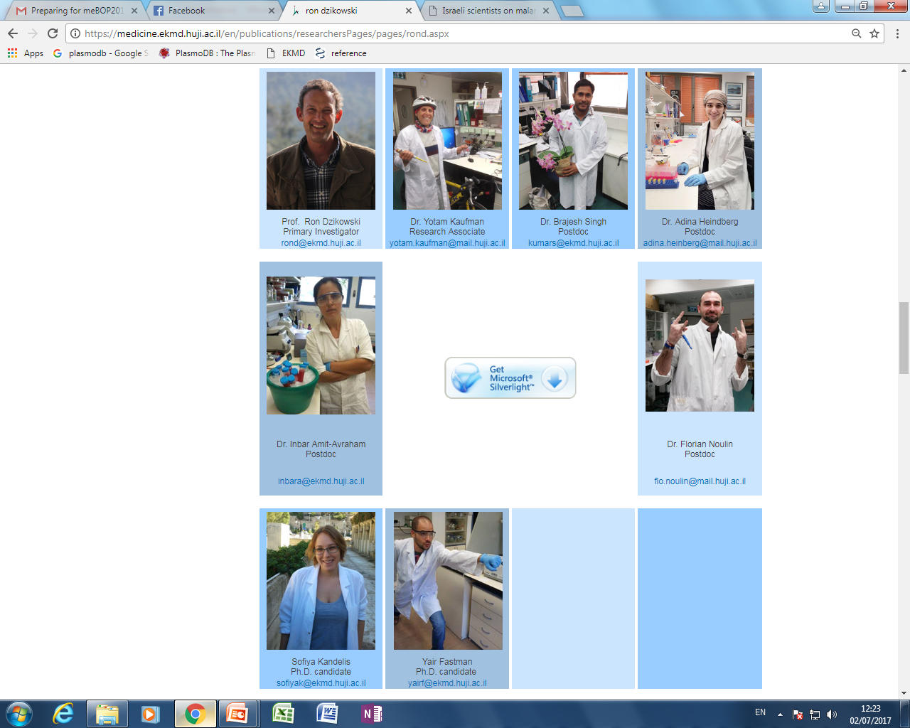
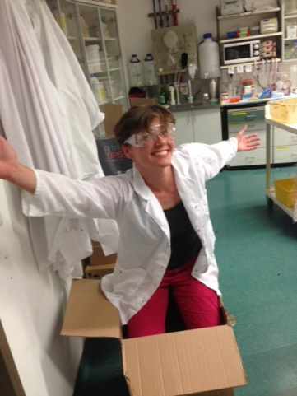

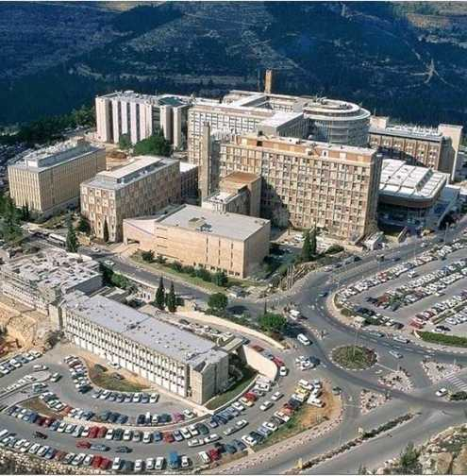
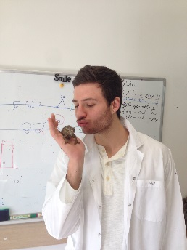
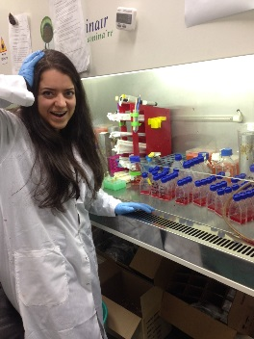
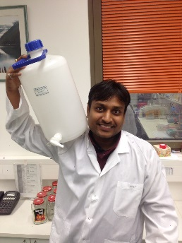
Malaria is in my blood
M.A (and PHD)

Slide 4
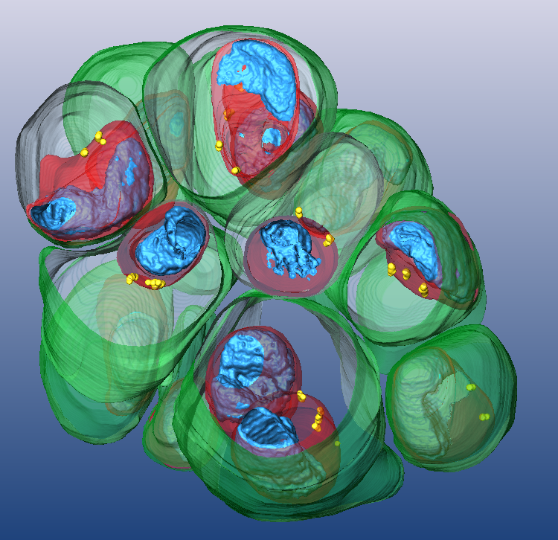


The main research questions in my lab
Gene regulation in Plasmodium parasites
Notes:
Intro:

Slide 5
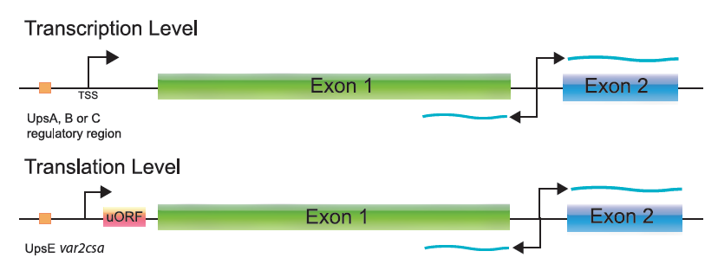
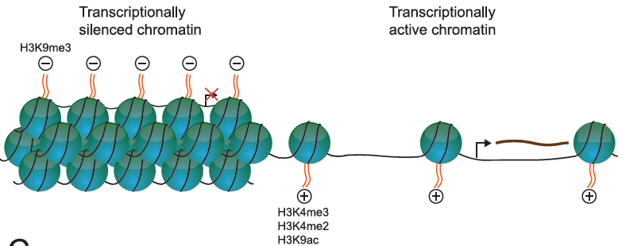
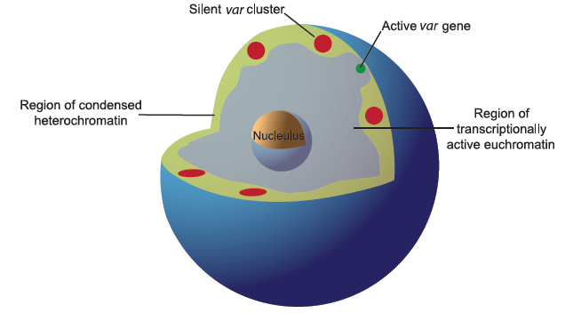
Mechanisms involved in the regulation of var gene transcription:
Repression and activation
Dzikowski & Deitsch, (2009)
Notes:
It is clear that regulation of var gene transcription happens in several layers: the level of the gene, chromatin remodeling and nuclear organization. In my project I propose to focus on understanding the basic level of gene transcription since each gene is a complete unit that contains all regulatory elements that can either keep it silent or active.

Slide 6
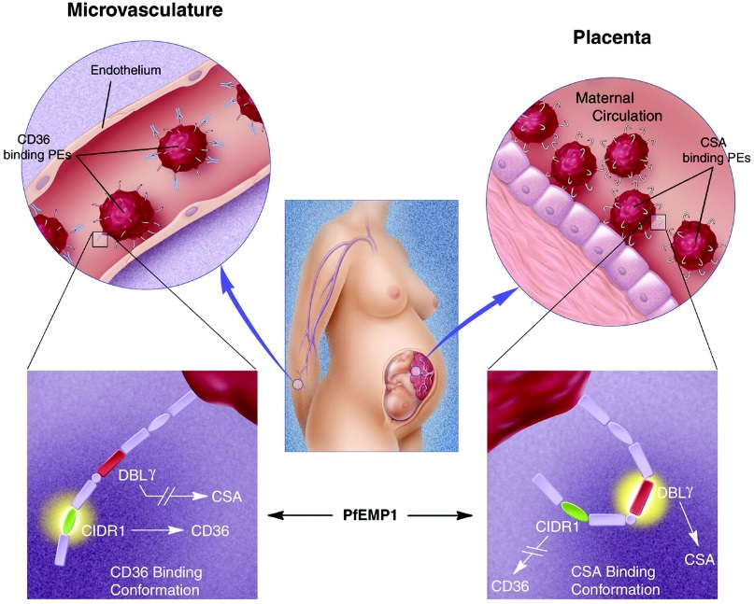
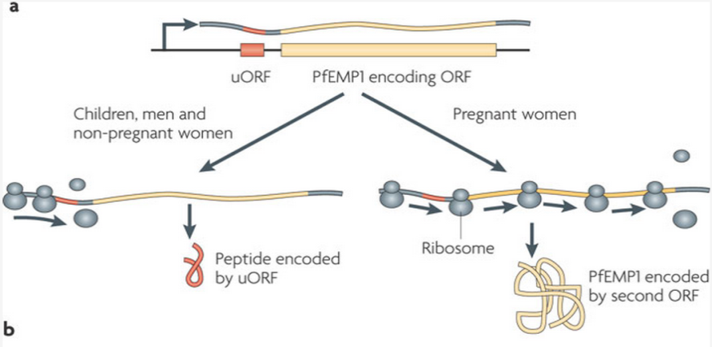
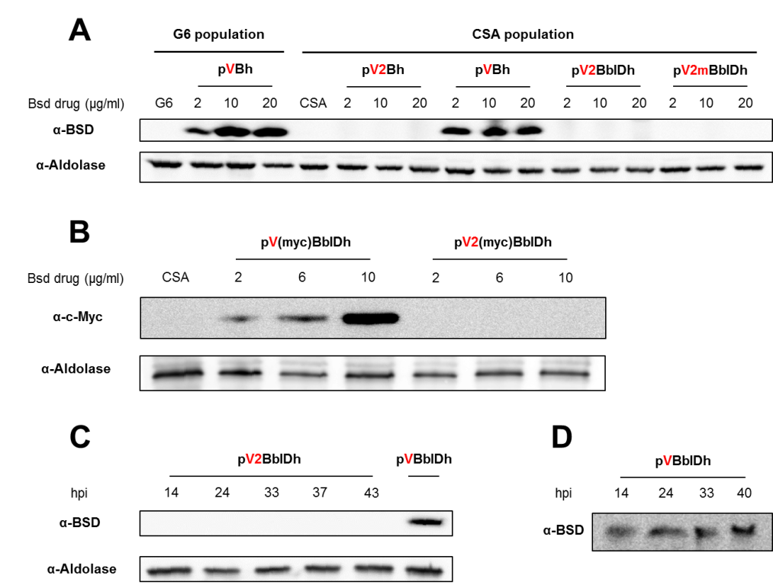
Regulation of var2csa, the gene responsible for pregnancy associated
malaria
Nature Reviews Microbiology 7, 493-503 (July 2009)
BSD
hDHFR
var promoter
uORF
BSD
hDHFR
var2csa promoter
V2B∆uORF
VB+uORF
α-BSD

Slide 7
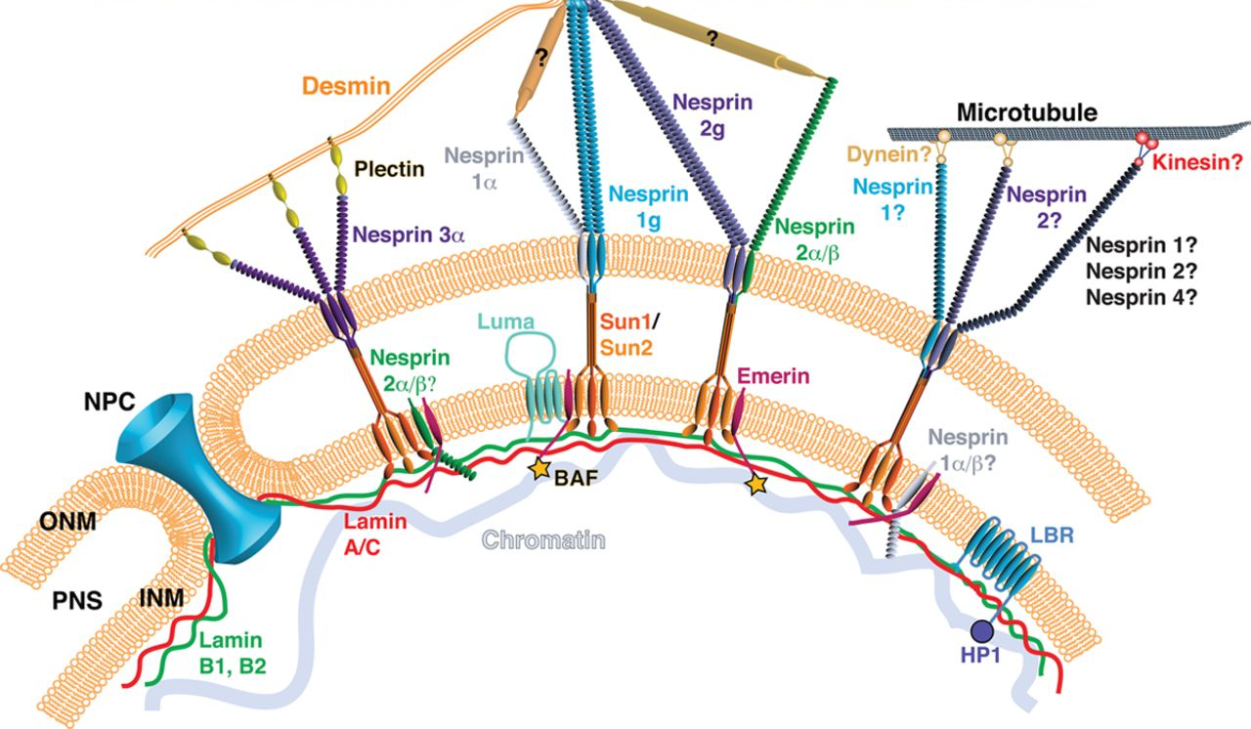
Role of KASH-domain proteins in regulating nuclear dynamics
LINC complex

Slide 8
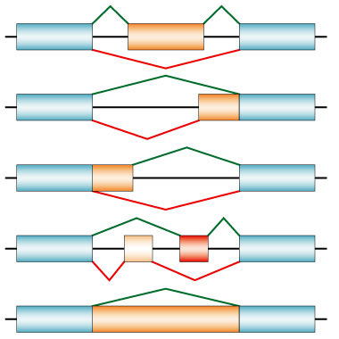
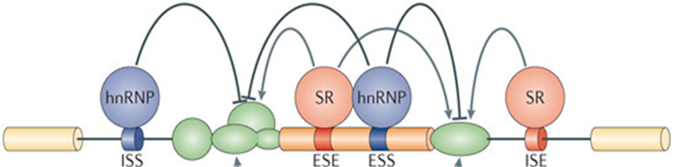
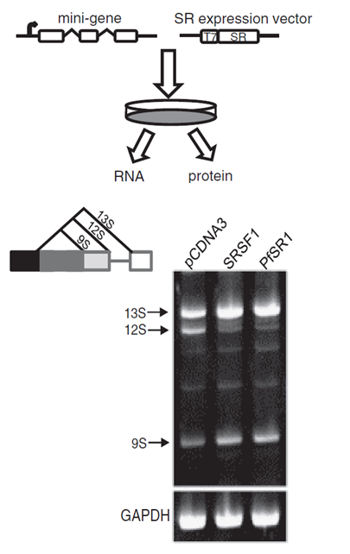
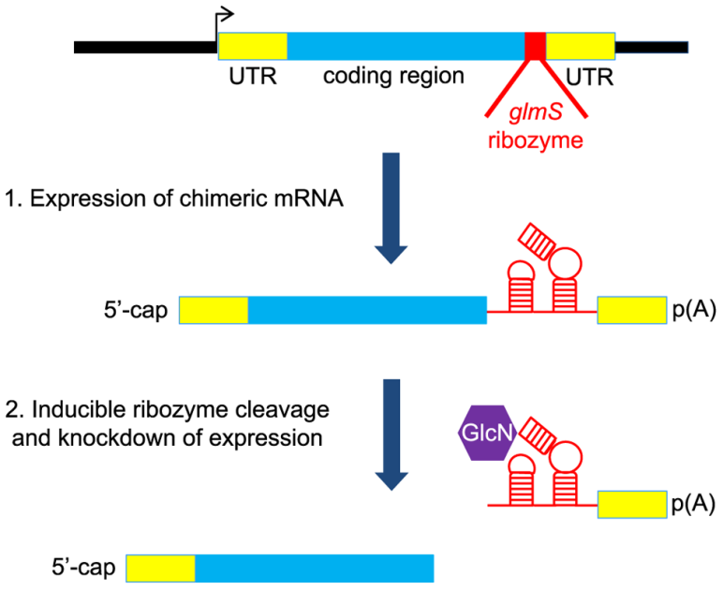
The role of alternative splicing in Plasmodium biology
SR proteins are regulators of alternative splicing
Used the CRISPR/Cas9 to create inducible k/o line
Use transgenic lines to:
Proteomics – interacting proteins
RNA-seq – changes in AS and transcription
CLIP-seq – RNAs that are bound by PfSR1
Eshar et al, NAR 2012

Slide 9
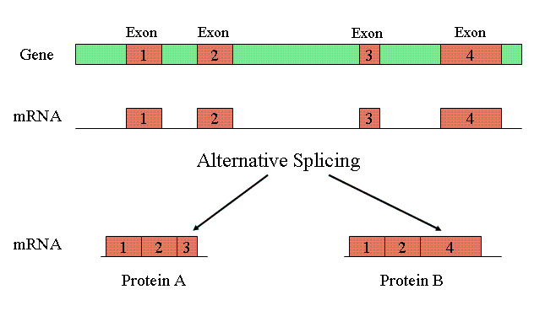
Alternative splicing

Slide 10
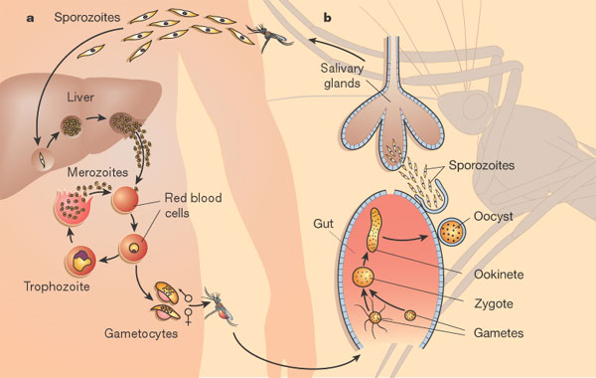
Alternative splicing
# of Genes

Slide 11
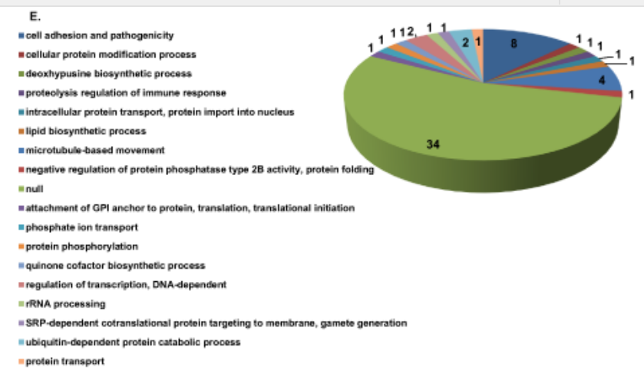
pfSR1
AS in cell adhesion and pathogenicity genes’ mRNAs
AS in transport proteins’ mRNAs
AS in lipid biosynthesis genes’ mRNAs
Over-expression of pfsr1 influence AS activity in P. falciparum

Slide 12
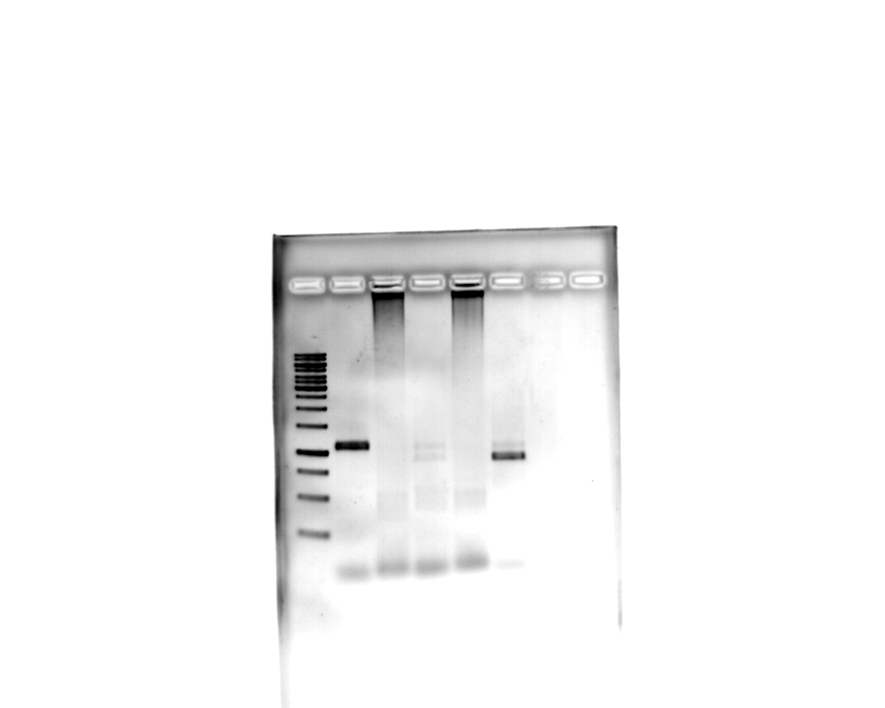

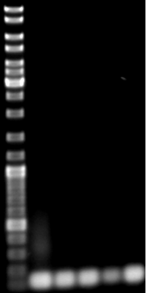
Pfsr1 autoregulation
2 µg/ml
blasticidin
A
20h
44h
B
bp
PfSR1
myc
PfSR1
myc
M
gDNA
pHBIRH
pHBIRH
1500
1000
Arginyl-tRNA
synthetase

Slide 13
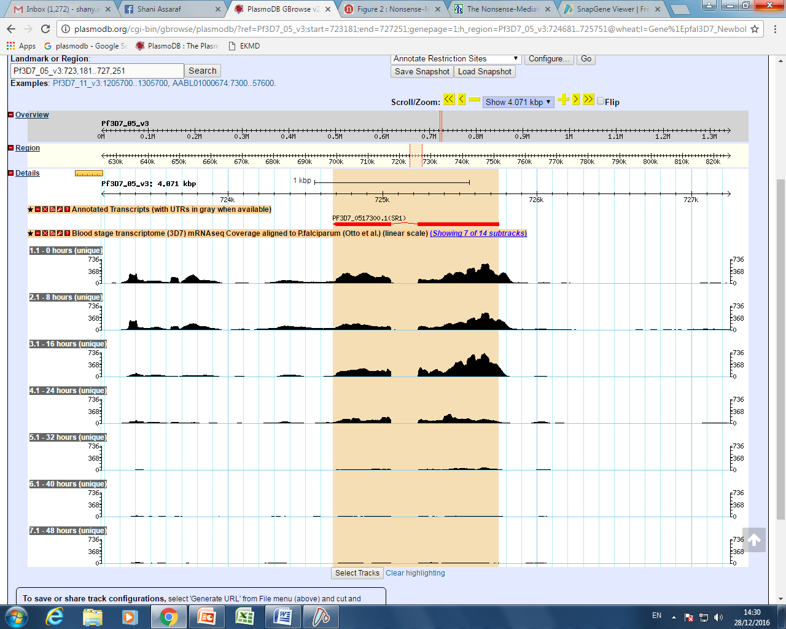
Early stages
RNA seq. by Otto et al.

Slide 14
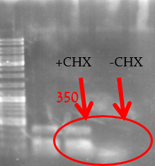
CHX experiment
Relative
copy number

Slide 15

My project right now
CHX
WB- protein level
qRTpcr- for showing that
increasing of exogenous pfsr1
leads to a decrease in
The endogenous pfsr1
Upf1 knockdown->
waiting for WR selection

Slide 16
Difficulties and strengths
In order to follow up changes in AS during KD, we need to analyze RNAseq of the full genome. In our lab there is a difficulty doing so.
Improving my Bioinformatics skills, and analyzing data.
Experienced in molecular biology methods.

Slide 17
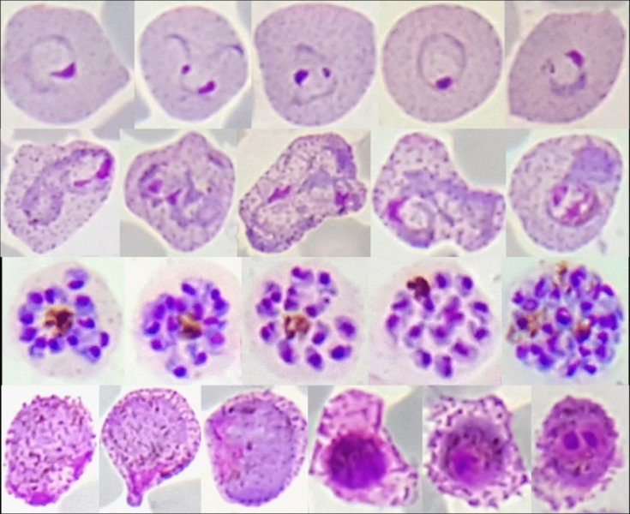
Thank you for
your listening

